Slide 1
ES 200: Summer 2019-2020
Environmental Studies : Science and Engineering
Module B: Solid Waste Management
Prof. Tabish Nawaz (Module C)
(tnawaz@iitb.ac.in)
Environmental Science and Engineering Dept.,
IIT Bombay
* Instructor In-Charge
(vsethi@iitb.ac.in)

Slide 2
Module C
Objectives of the Solid Waste Management Module
Identify the various types of solid wastes, their sources and understand their characteristics.
Comprehend the functional elements of a solid waste management system.
Analyze and evaluate the engineering aspects associated with the management of solid waste from the point of generation to final disposal.

Slide 3
Module C
Solid Waste Management
Lecture-1 Topics
Overview of the Module
Solid Waste Classification
Solid Waste Management System

Slide 4
Definition and Classification
The term “Solid Waste” includes all those solid and semi-solid materials that are discarded by a community.
Solid Waste generated through domestic and commercial activities is classified as municipal solid waste (MSW) and is also called refuse.
The solid waste generated by industries is Industrial Solid Waste.
Solid Waste may also be generated by agricultural activities, a large portion of which may also become a part of MSW.
However, animal and human excreta, are not included in MSW, although a portion of it may find entry into MSW.

Slide 5
Definition and Classification
A part of biomedical waste from hospitals and nursing homes finds entry into the MSW stream, though it is supposed to be disposed off separately as hazardous biomedical waste.
Generally, Solid Wastes are classified into:
Municipal Solid Waste (MSW)
Industrial Solid Wastes
Hazardous Wastes
Sources of MSW
1. Residential
2. Commercial
3. Open Areas
4. Treatment Plant Sites

Slide 6

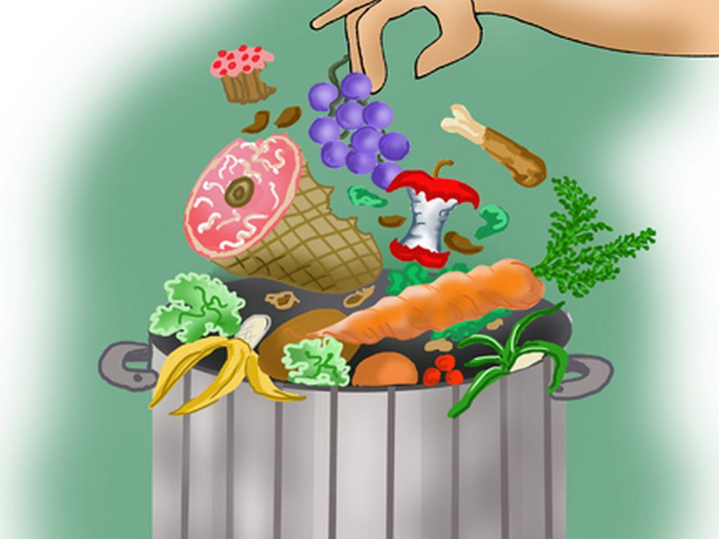

Components of MSW
MSW is a heterogenous mixture of various kinds of solid wastes, not transported with water as sewage.
Garbage: Includes all sorts of putrescible (bio-degradable) organic wastes obtained from kitchens, hotels, restaurants.
Because food waste are putrescible, they decompose rapidly, especially in warm weather, producing foul odors and health hazards.
They also result in breeding of flies, mosquitoes, insects etc.
If scientifically processed and composted, valuable products like grease, fertilizer, hog wood etc. can be obtained from garbage.
Density of garbage usually varies from 450 to 900 kg/m³

Slide 7
Components of MSW
Rubbish: Includes a variety of materials which are not readily putrescible
Combustible (paper, textile, plastic)
Incombustible (broken glass, crockery, metal, masonry)
Density of rubbish usually varies from 50 to 400 kg/m³.
Incombustible Ashes from household hearths (chulhas)
Ashes and residues are composed of fine powdery materials, cinders, clinkers, and small amount of burned and partially burned materials.
Due to increasing use of cooking gas and lesser use of cooking coal and firewood in urban areas, quantity of ashes is reducing.
Density of ashes varies from 700 to 850 kg/m³.

Slide 8
Components of MSW
Street Sweepings: fine dust, silt, sand.
Special Wastes: Construction debris, abandoned appliances, automobiles.
Ashes from thermal power plants, sludges from wastewater treatment plants, wastes from animal feedlots, mine tailing, biomedical wastes and other industrial wastes are not responsibility of municipal bodies, and require special arrangements.
Other Components in MSW: Soda cans, plastic bottles and containers, plastic toys, and appliances
Refuse may also be classified depending on source:
(i) house refuse (ii) street refuse, (iii) trade refuse

Slide 9
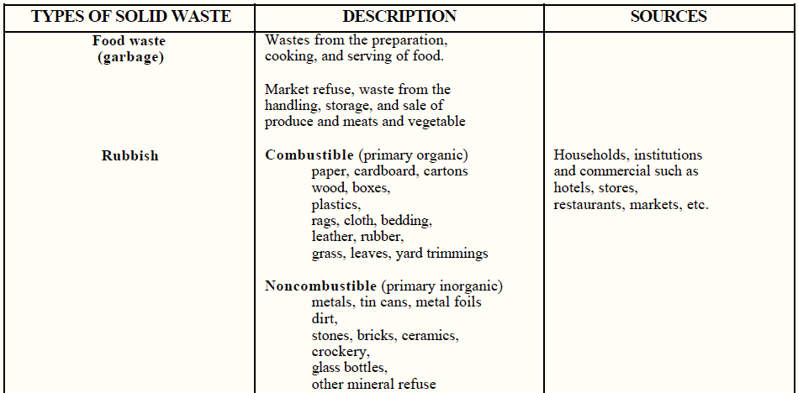
Classification of Solid Wastes
Continued

Slide 10
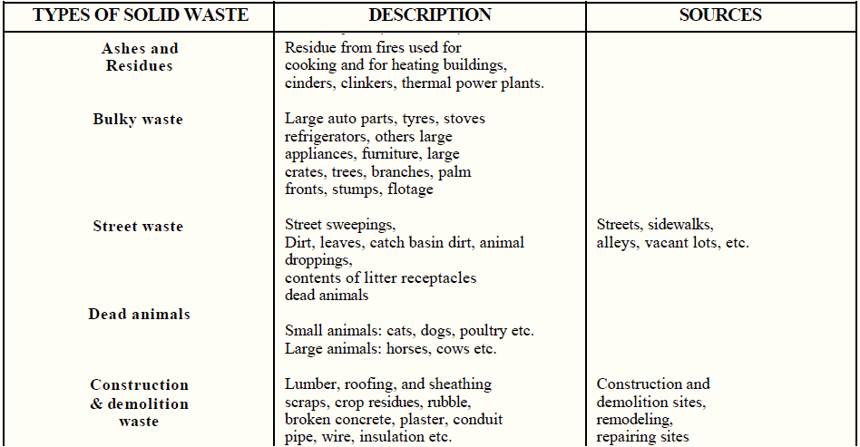
Classification of Solid Wastes
Continued

Slide 11
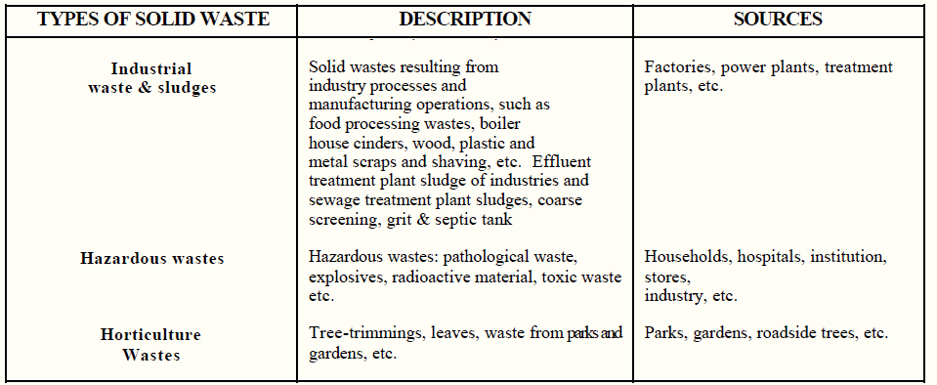
Classification of Solid Wastes
This Solid Waste classification applies for Developing Countries

Slide 12
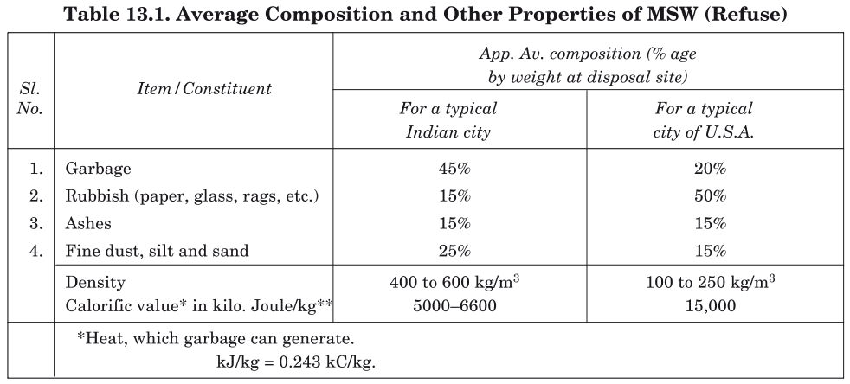
Quantity and Composition of MSW
Quantity of MSW depends on the standard of living.
Degree of commercialization, urbanization, industrialization have positive correlation with quantity of per capita refuse production.
Average Composition and properties of MSW

Slide 13
Difference in MSW composition in developing and developed nations
Presence of rubbish in Indian refuse is small as compared to USA, due to removal by rag pickers, thereby reducing the calorific value of Indian refuse.
Quantity of garbage in USA is very small because of the use of garbage grinders and use of tinned and ready-made packed foodstuffs.
The density of Indian refuse is higher than developed countries
Can be Carried efficiently and economically by mechanical transport for land fillings
Low calorific value and high moisture content makes incineration unsuitable for disposal

Slide 14
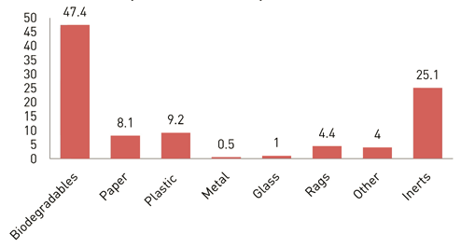
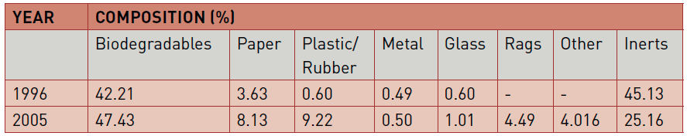
Typical Fractions of MSW in India
Source: Study conducted by CPCB & NEERI (2005)

Slide 15
Quantity and Composition of MSW
The quantity and general composition of the MSW is of critical importance in the design and operation of solid waste management system.
Methods for estimating quantity of solid waste generated:
Load-Count Analysis
Quantity and composition determined by recording the estimated volume and general composition of each load of waste delivered to a landfill or transfer station during a specific period of time.
The total mass and mass distribution by composition is determined using average density.
Mass-Volume Analysis
Similar to above method but mass of each load is recorded in addition.

Slide 16
Quantity and Composition of MSW
Factors affecting generation rates:
Geographic location
Season of the year
Collection frequency
Use of kitchen waste grinders
Characteristics of the populace
Extent of salvaging and recycling
Public attitudes
Legislation

Slide 17
MSW generation data for India
NEERI Study (2004-2005)
59 cities (35 metro cities and 24 state capitals) were studied
Waste generation rate varies from 0.12 to 0.60 kg/capita/day.
Analysis of physical composition indicates that:
Total compostable matter in the waste ~ 40%–60%,
Recyclable fraction ~ 10%–25%.
The moisture content in the MSW ~ 30%–60%
C/N ratio is 20–40.
CPCB Study (2013-2014)
1,43,449 tpd of MSW was generated for 34 states and union territories.
The average rate of waste generation is 0.11 kg/capita/day.

Slide 18
Need for an effective Solid Waste Management
Black Death (Yersinia pestis) 14th century Europe, which killed 1/3 of European population.
Bacteria thrived due to the prevailing sanitary conditions in the cities.
Yersinia infects fleas, which travel on rats and huge populations of rats could be found in every major city in Europe.
Improper collection and disposal of a society’s refuse.
Outbreak of Pneumonic Plague in September 1994 in Surat City of Gujarat.
“Crowded living conditions and refuse contaminated flood waters around the shanty towns of Surat provided a breeding ground for rats and infected fleas”
Clem, Angela & Galwankar, Sagar. (2005). Plague: A decade since the 1994 outbreaks in India. The Journal of the Association of Physicians of India. 53. 457-64.

Slide 19
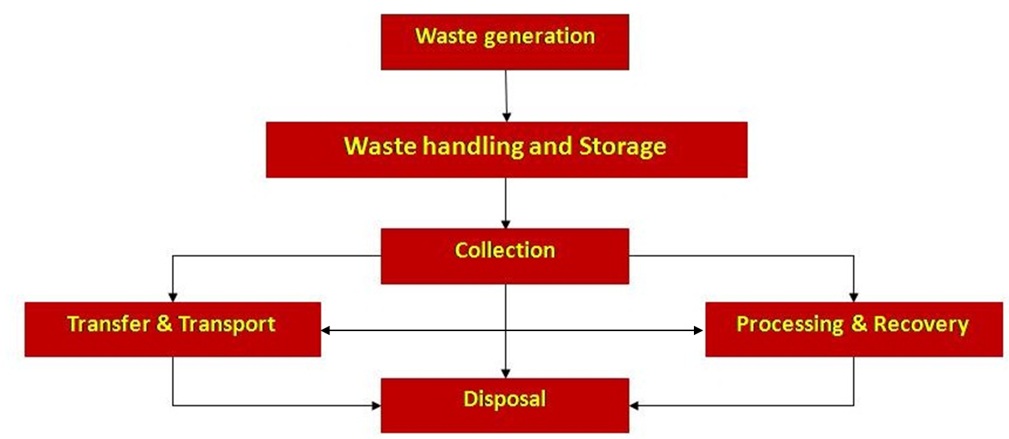
Functional elements of a solid waste management system

Slide 20
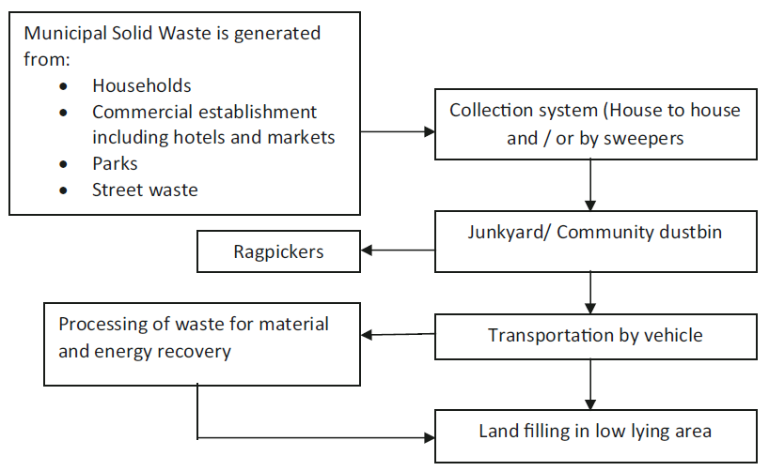
Solid Waste Management System in India
Singh RP, Singh P, Araujo ASF, Ibrahim MH, Sulaiman O (2011a) Management of urban solid waste: vermicomposting a sustainable option. Resour Conserv Recycl 55(7):719–729

Slide 21

Solid Waste Management in India
In its scope, solid waste management includes all administrative, financial, legal, planning, and engineering functions involved in the whole spectrum of solutions to problems of solid wastes.
Swachh Bharat Vision Statement articulated in the address of The President of India in his address to the Joint Session of Parliament on 9th June 2014:
“We must not tolerate the indignity of homes without toilets and public spaces littered with garbage. For ensuring hygiene, waste management and sanitation across the nation, a “Swachh Bharat Mission” will be launched…”

Slide 22
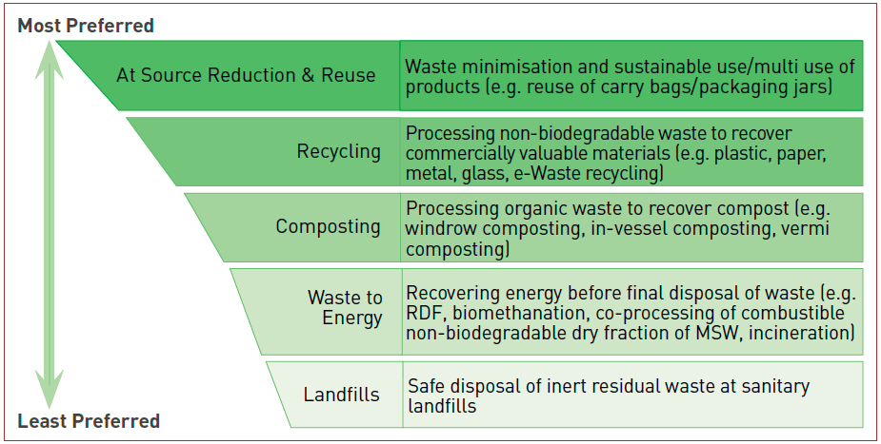
Integrated Solid Waste Management Hierarchy

Slide 23
Solid Waste Management in India
Adopt suitable measures for waste minimization at source with an emphasis on the principles of 3Rs
Reduce
Reuse
Recycle
Principles of 3 Rs
Integrated SWM is a strategic approach to MSW management in a sustainable manner by considering the generation, segregation, transfer, sorting, treatment, recovery, and disposal of waste in an integrated manner, with an emphasis on maximizing efficiency of resource use.

Slide 24
Legislations Governing Solid Waste Management
Environment (Protection) Act 1986
Solid Waste (Management and Handling) Rules, 2000
Municipal Solid Waste Management Rules, 2016
Level of Government | Role
Central | Development of Legal & Policy Framework
State | Overall responsibility for the enforcement of the provisions of SWM rules and development of SWM strategy
District/Regional | Facilitate identification and allocation of suitable land and review the performance of local bodies
Municipal Authorities | Primarily responsible for the provision of MSW management services.

Slide 25
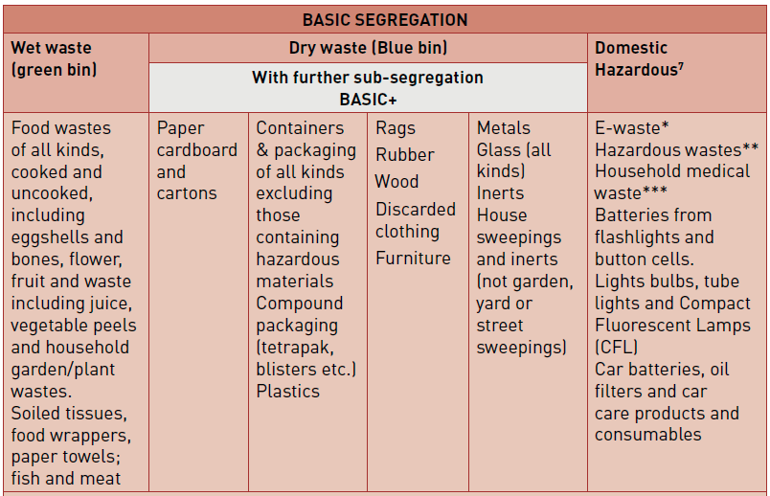
Segregation of Household Wastes

Slide 26
List of Domestic Hazardous Wastes
* E-waste: Printer & printer cartridges, electronic parts and equipment
** Hazardous wastes: Chemicals and solvents and their empty containers, paints, oil, lubricants, glues, thinners and their empty containers, insecticides, pesticides and herbicides and their empty containers, photographic chemicals, bleaches and household kitchen & drain cleaning agents
*** Household Medical Waste: Thermometers and other mercury containing products, discarded medicines, injection needles and syringes after destroying them both, sanitary wastes and diapers (should be collected daily)
Manual on Municipal Solid Waste Management – 2016, Central Public Health & Environmental Engineering Organization (CPHEEO)

Slide 27
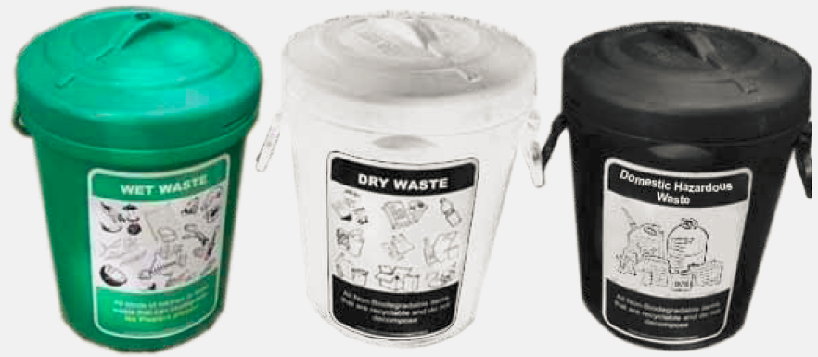
Segregation of Wastes
Covered Green Bin: Wet biodegradable waste
Covered White Bin: Recyclable waste
Covered Black Bin: Domestic Hazardous Waste
Bins for Collection of Dry, Wet and Domestic Hazardous Waste at Households

Slide 28
Segregation of Household Wastes
As directed by SWM Rules, 2016: Clause 4, duties of waste generators:
Segregate and store the waste generated by them in three separate streams namely bio-degradable, non -biodegradable and domestic hazardous wastes in suitable bins and handover segregated wastes to authorized waste pickers or waste collectors
wrap securely the used sanitary waste like diapers, sanitary pads etc., in the pouches provided by the manufacturers or brand owners of these products or in a suitable wrapping material as instructed by the local authorities and shall place the same in the bin meant for dry waste or non- bio-degradable waste.

Slide 29
Summary Questions
What are the principal differences between the composition and quantity of municipal solid waste in developed and developing nations?
What is the advantage of segregating solid wastes at the source?
Responses to these questions should be typed in a word document and sent by an email to TAs until 21st September 2020

